Slide 1
English

Slide 2
Reading

Slide 3
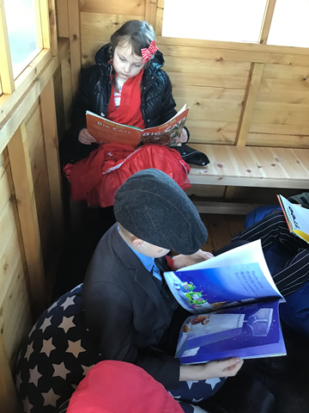
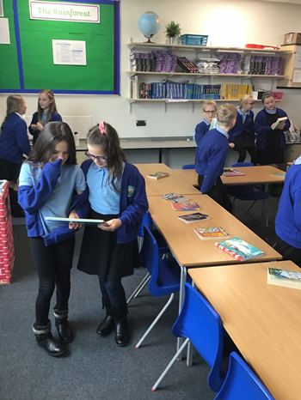
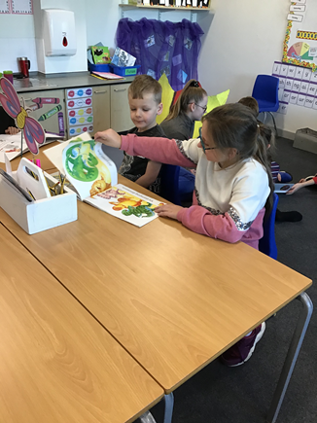
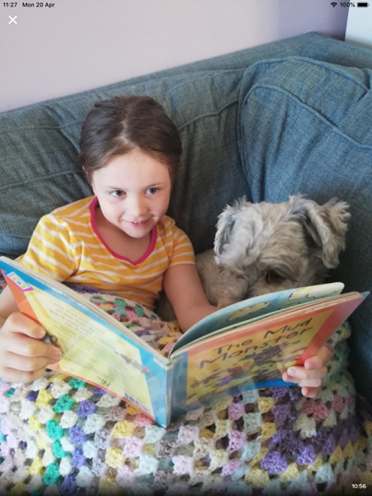
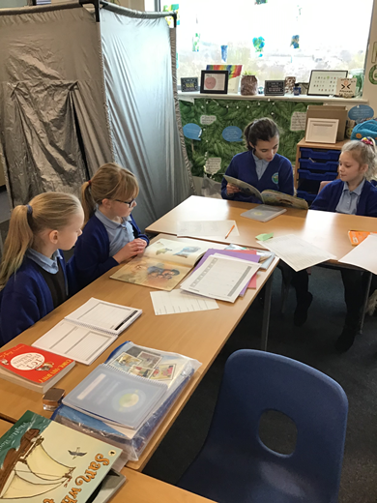
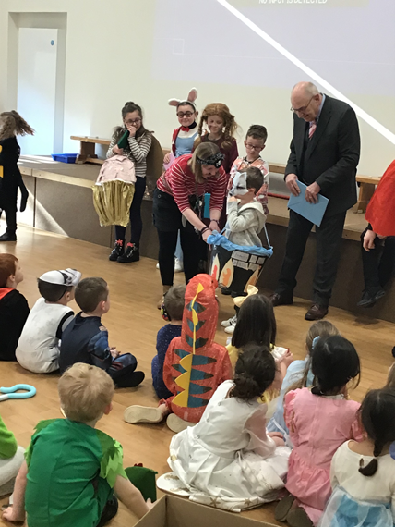
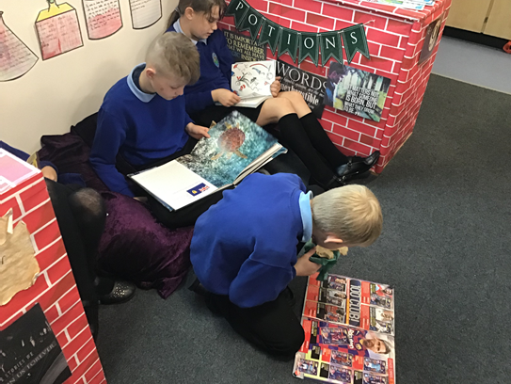
Reading

Slide 4
EYFS
Focus texts

Slide 5
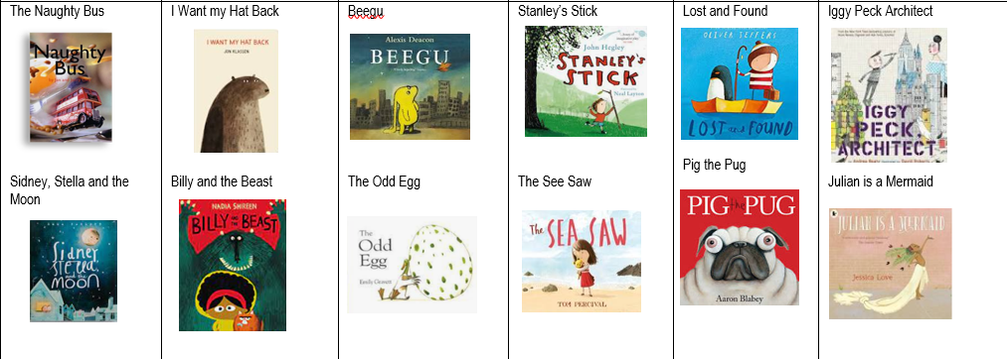
Year 1
Focus texts

Slide 6
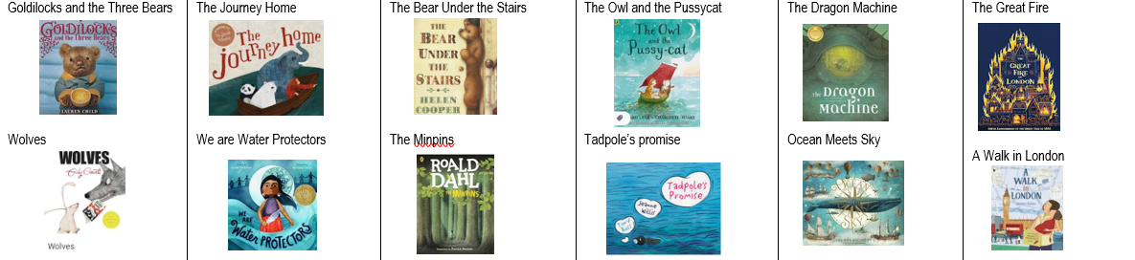
Year 2
Focus texts

Slide 7
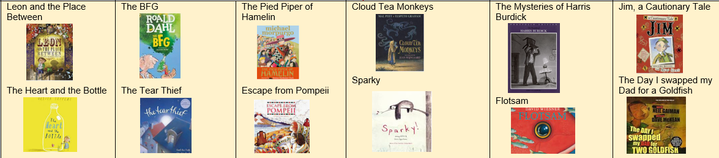
Year 3
Focus texts

Slide 8
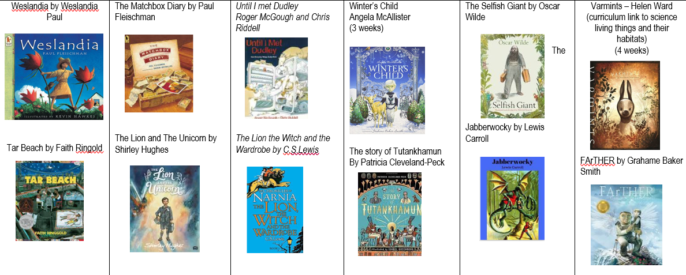
Year 4
Focus texts

Slide 9
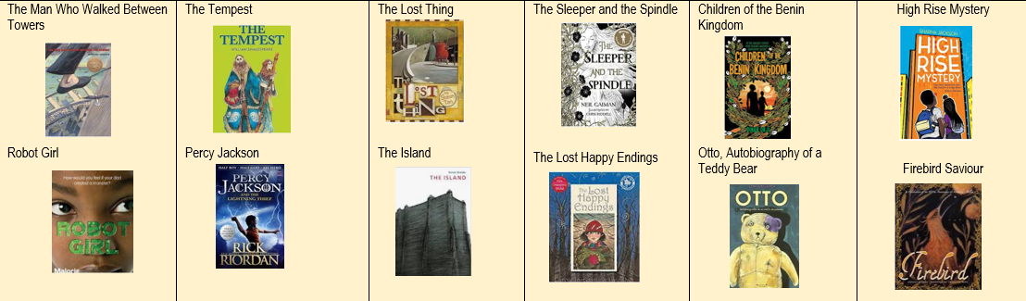
Year 5
Focus texts

Slide 10

Year 6
Focus texts

Slide 11
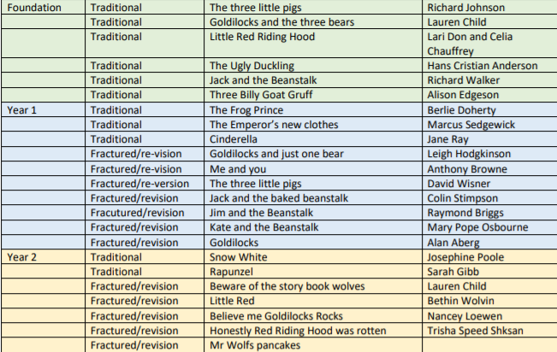
Progression in traditional tales
EYFS/ KS1

Slide 12

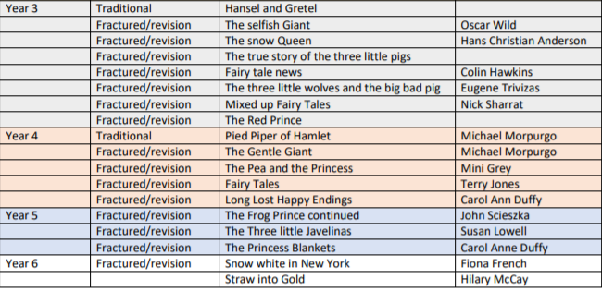
KS2

Slide 13

Book blethers
Daily class story
1:1 reading
Reading volunteers
Reading for pleasure
Buddy reading
Opportunities
Reading corners
Guided/Shared reading
Visits to the library
Poetry/ rhyme every day
Reading ambassadors
Library area/ cottage
Reading at home

Slide 14
Writing

Slide 15


Slide 16
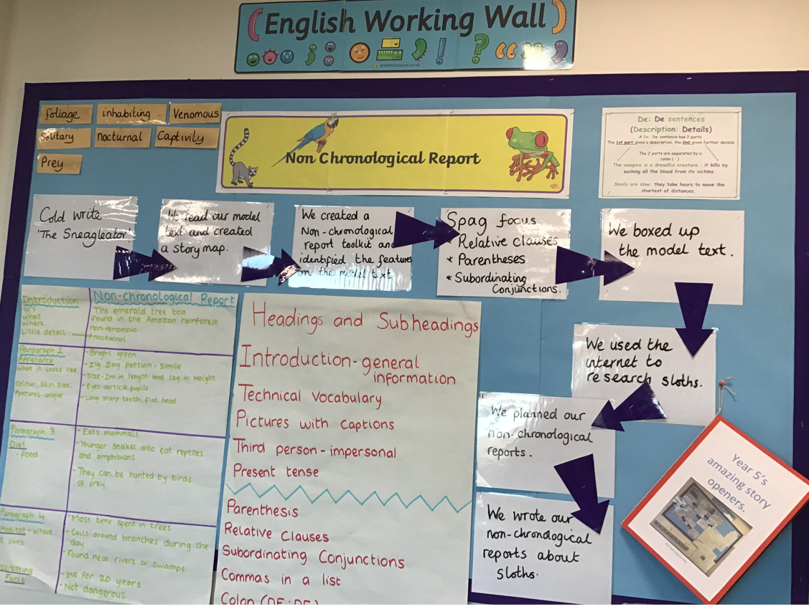
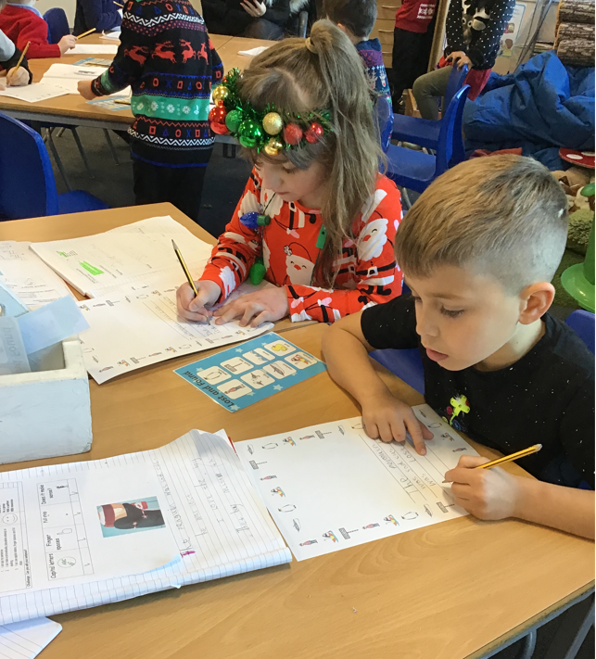
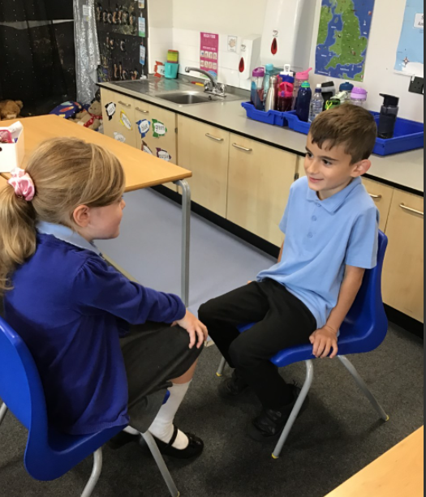
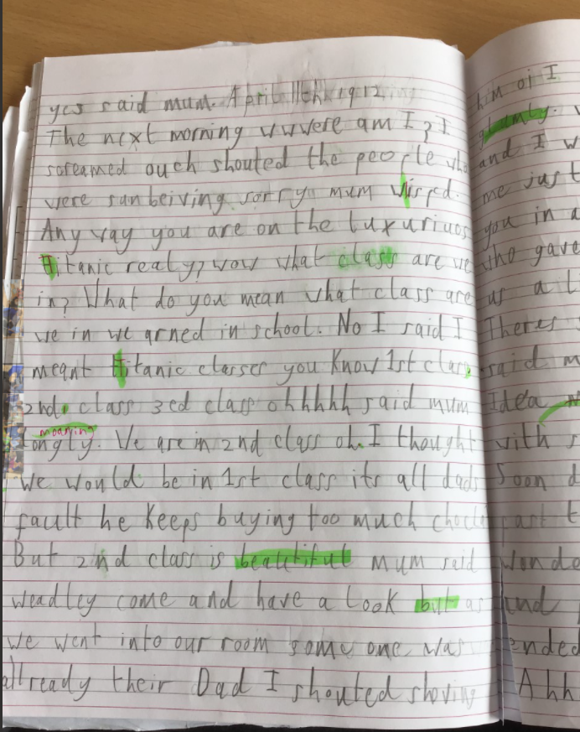

Slide 17

Opportunities for writing in foundation subjects
Creative writing books
Writing a science experiment
Creating and writing problems in maths
Writing in English

Slide 18
Speaking and listening
Tier 3
Children are assessed by S&L specialist
Tier 2
Interventions
Tier 1
Opportunities for speaking and listening
Foundation- Story sacks
KS1- Memory box
KS2- What I am proud of
Talk partners, drama, sharing opinions and beliefs, debate

Slide 19
S.P.A.G
Spelling- Spelling shed- linked to NC
Punctuation-Following NC and non-negotiables
Grammar-Included in lessons- linked to writing genre

