Slide 1


Slide 2
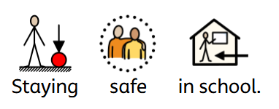
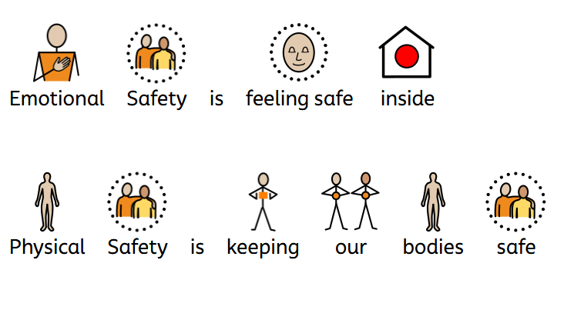
Staying Safe at Lawrence View Primary and Nursery School
Our school is a safe place where adults and children work together to keep everyone safe.
In school we look after your body and your feelings
Emotional safety means feeling safe inside – safe to be yourself and share your feelings
Physical safety means keeping our bodies safe from getting hurt.

Slide 3
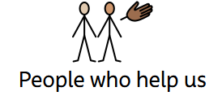

People Who Help Us
Teachers
Teaching Assistants
Lunchtime Staff
Office Staff
Senior Leaders

Slide 4
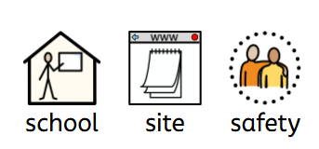
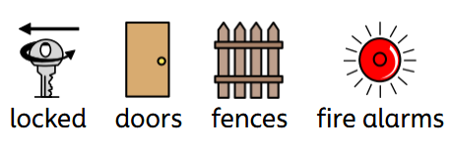
School Site Safety
Locked gates and doors help keep us safe.
Fences protect our school space.
Signing in systems in school.
Fire alarms
Fire hydrons/sprinklers
Reporting systems

Slide 5
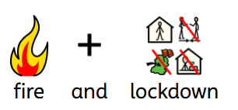
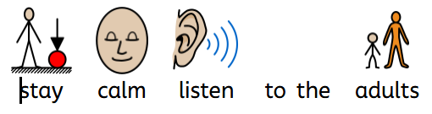
Lockdown/ Fire Safety
Stay calm
Stay together
Listen to adults
Adults are trained to keep you safe.
(talk through school procedures)
Fire doors are there to help if there is a fire, these should always be shut and free from clutter

Slide 6
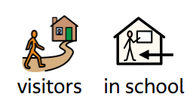
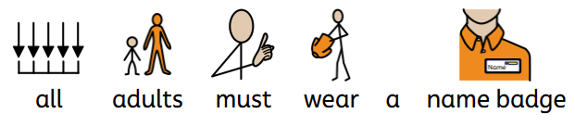
Visitors
All adults in school must wear a Lanyard with their name on or Visitor.
Visitors wear BLUE lanyards
Tell a trusted adult if someone has no lanyard on.
Remember your STRANGER DANGER

Slide 7

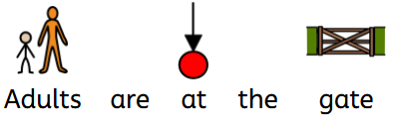

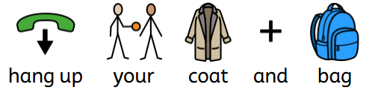
Arriving at School Safely
Adults in fluorescent tabards are at the gates and are there to help if you need anything.
Come straight into school
Go directly to your classroom
Make sure all your equipment is put on your peg.

Slide 8
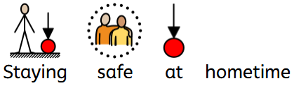
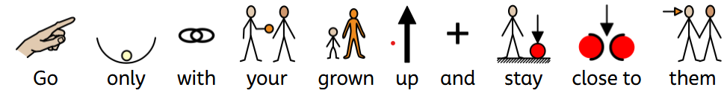
Staying Safe at Home Time
Go only with your grown-up
Stay close to them
If walking home alone go straight home.

Slide 9
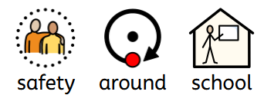
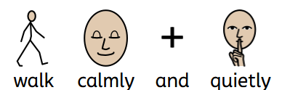
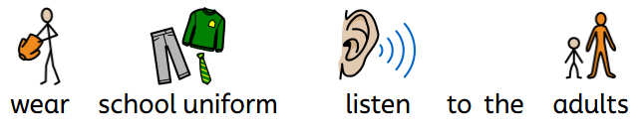
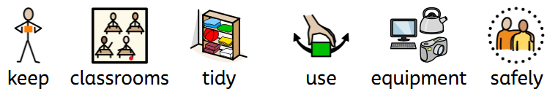
Safety around school.
Keeping safe around school is really important, that is why we have rules.
Always walk calmly and quietly
Wear the correct school uniform- these colours help us identify you quickly
Use equipment safely
Keep the classroom/ school tidy- hang your coats and bags on hooks provided
Listen to adults

Slide 10
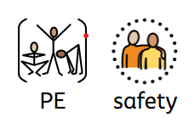
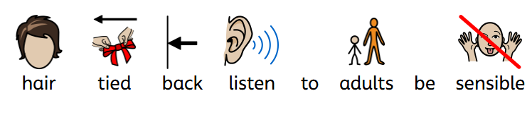
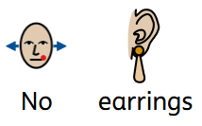
PE Safety
During PE Correct PE kit is essential for safety
• No jewelry
• Hair tied back
• Listen carefully to adults
Work quietly and be mindful of those around you.

Slide 11
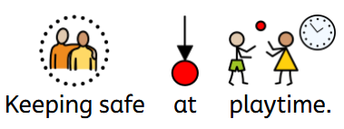
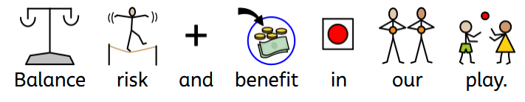
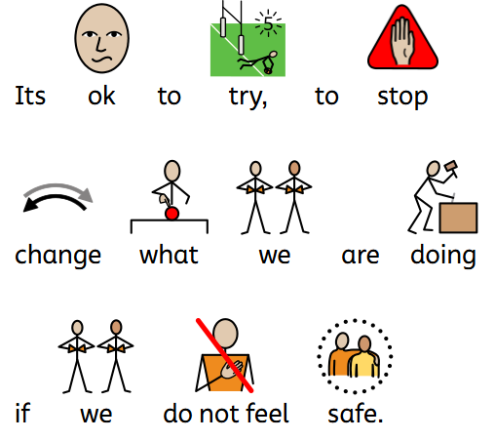
Keeping Safe at Playtime
OPAL playtime we:
Think about what we are doing
Decide if something is safe enough
Balance risk and benefit in our play
This means Stopping and thinking before we act
Trying new things safely.
Changing what we do if something feels unsafe.
It’s OK to try
It’s OK to stop
It’s OK to say “this isn’t safe”

Slide 12
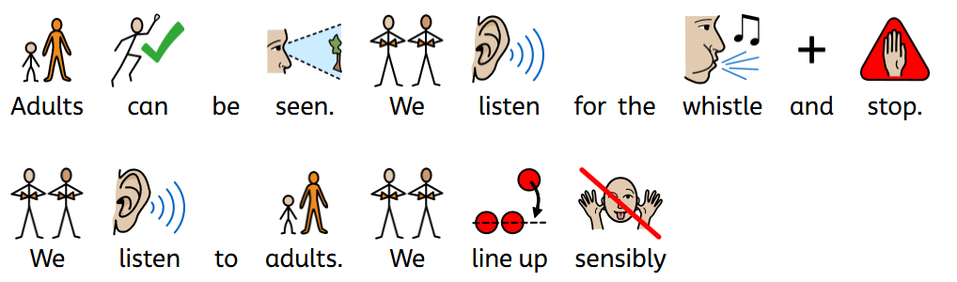
Our adults can be seen easily at playtime to help us find them.
They wear tabards
Listen out for the whistle which tells us to stop and listen.
We follow adults' instructions
We walk in sensibly after play.

Slide 13
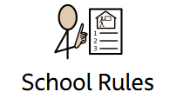

Our School Rules
Rules help stop accidents
We have 3 school rules
READY RESPECTFUL SAFE
Ready keeps us safe-
We listen carefully
Follow instructions
Act calmly to avoid accidents

Slide 14
Respectful Keeps Us Safe
Kind words and actions stop people getting hurt and help everyone feel safe.
Respecting and looking after our environment helps us keep safe.
Listening to our adults respectfully helps us keep safe
Safe
We look out for others
Help friends
Tell an adult if someone needs help

Slide 15
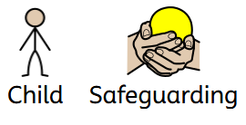
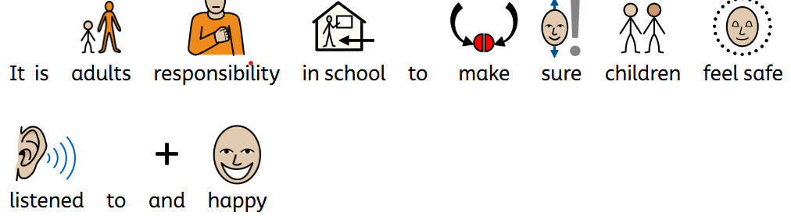
Safeguarding
Safeguarding means protecting children, so they feel safe, happy and listened to.
In school it is every adult's responsibility to make sure this happens.
Who Can You Talk To?
Your teacher
Any trusted adult -DSLs: Mrs McGrenaghan, Mr Blackburn and Miss Stevenson.

Slide 16
What is a DSL?
A DSL is a grown‑up in school whose job is to keep children safe.
They: Listen to children.
Help if something is worrying you.
Make sure you are safe and looked after.
You can talk to them if: You feel worried-You feel unsafe-Something doesn’t feel right.
You will never be in trouble for telling a DSL.

Slide 17

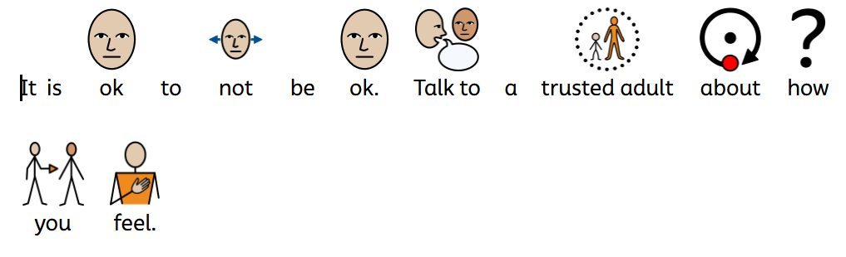
Mental Health Matters
Everyone has mental health
It is OK not to feel OK knowing this keeps everyone safe.
Talking helps to trusted adults and friends.
We have mental health ambassadors in school Children who help others feel included and encourage asking for help

Slide 18
Help Outside School
Childline: 0800 1111
NSPCC help keep children safe

Slide 19

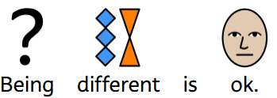

Protected Characteristics
Some parts of who people are protected
This means everyone must be treated fairly
How This Keeps Us Safe in School
Being different is OK.
Everyone is important.
No one should be treated badly because of who they are.
Unkind behaviour is not allowed.

Slide 20
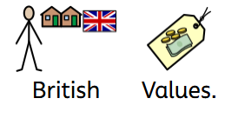
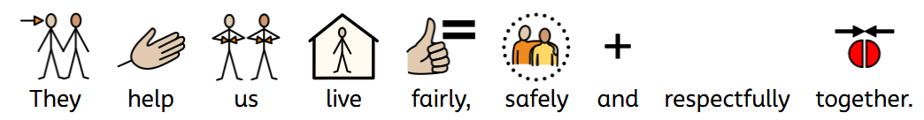
British Values Help Us Stay Safe
British values help us live safely, fairly and respectfully together.
Mutual Respect
Treat others kindly
Listen to different views
Tolerance of different beliefs
People can think and believe differently
• Kindness helps everyone feel included
Rule of the Law
Rules keep us safe
Adults make rules to protect children
Individual liberty
You have a voice
It is OK to ask for help
Speak up if worried

Slide 21
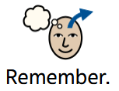
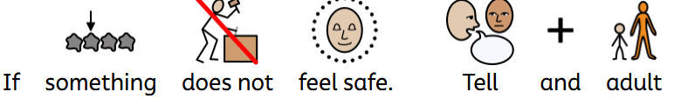

Remember
If Something Is Not Right
Tell a trusted adult
Speak to your teacher
Talk to a safeguarding adult
It is always OK to tell someone
Adults are here to help keep you safe

